Slide 1
LS 225 – Closures and Function Scope
April 24, 2020

Slide 2
Assignments and problems
Closures + function review
Higher order functions
Practice
Closures and private data
Closures
Objects and closures
Banking with objects and closures
Garbage collection
How closures affect garbage collection
Practice
Partial function application
Practice
Immediately invoked function expressions
Create private scope with IIFE
Create private data with IIFE
Practice
Summary
Quiz

Slide 3
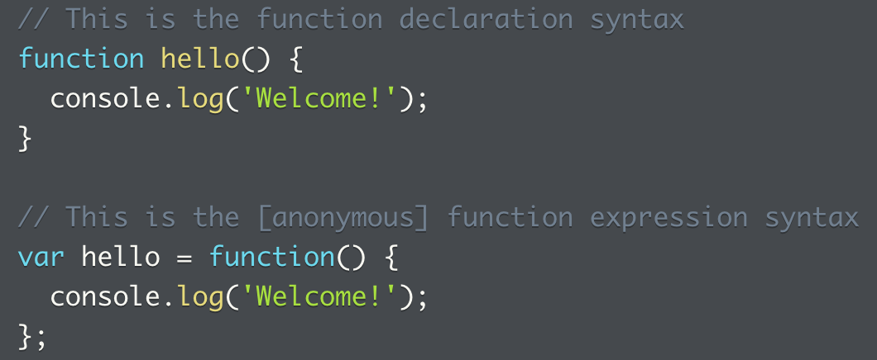
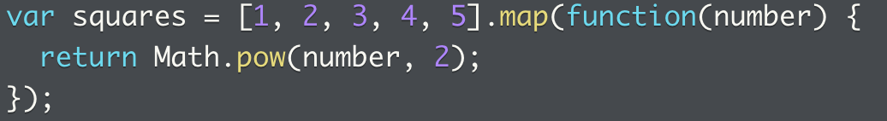
Closures and functions review
Functions are created with the `function` keyword
There are two ways to define a function:
Function declaration syntax
Function expression syntax
When would you use a function expression?
When passing function to another function as argument or return value
Functions observe lexical scoping rules:
Access any variables defined within it
Access any variables in scope based on context where function was defined
Review of functional scope and lexical scoping rules: https://launchschool.com/lessons/511a561c/assignments/a480ef58

Slide 4
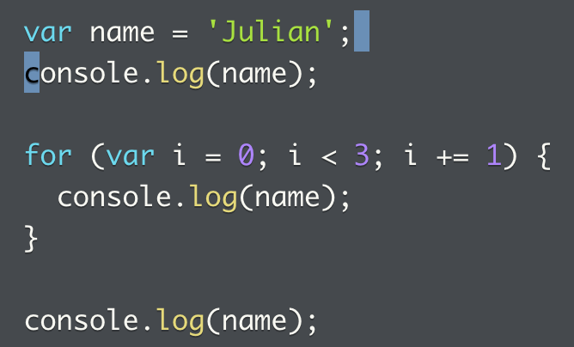
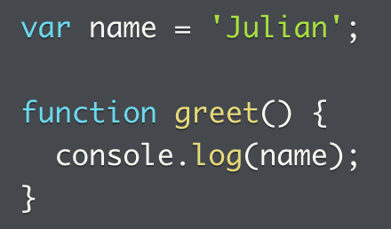
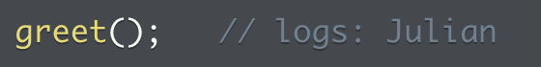
A review of functional scopes and lexical scoping rules
What is scope?
Variable scope = part of program that can access variable by name
Variable scoping rules describe where language finds and retrieves values from previously declared variables
Every function creates a new variable scope in JS
Small program with no functions, exists within a single scope, the global scope
Adding a function results in the creation of function scope, in addition to the global scope

Slide 5
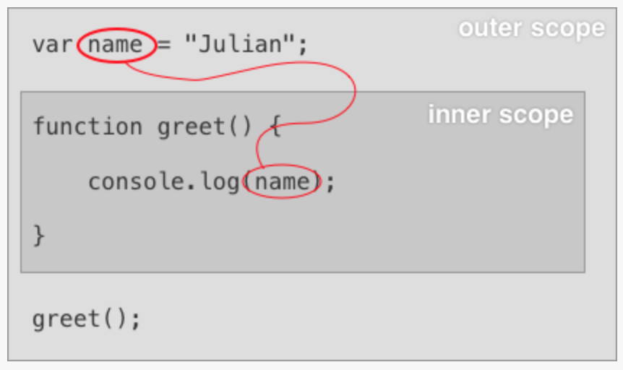
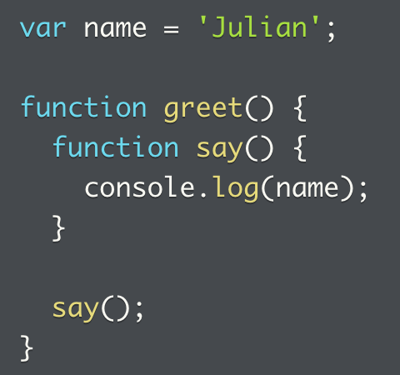
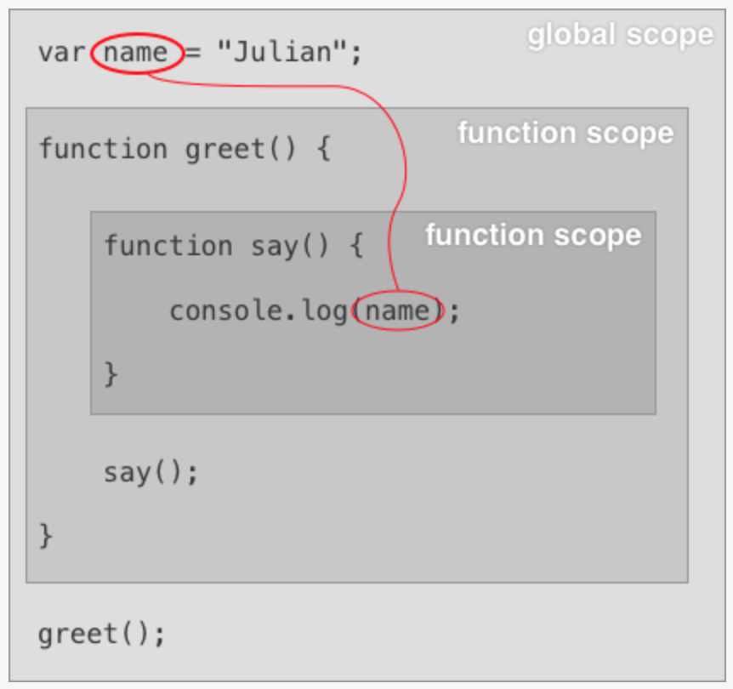
Lexical scopes – function scopes
Referring to the last example, when `greet` is invoked, the `name` variable is accessed, since code within function can access all variables in surrounding scopes
Function scopes nest inside each other, code within an inner scope can access any variables in the same or surrounding scope
This works regardless of how deeply nested a function is => in this function, `say` can access `name`, even though `say` is nested inside of `greet`, and `greet` inside of outermost scope
Behaves the same to version without `say`

Slide 6
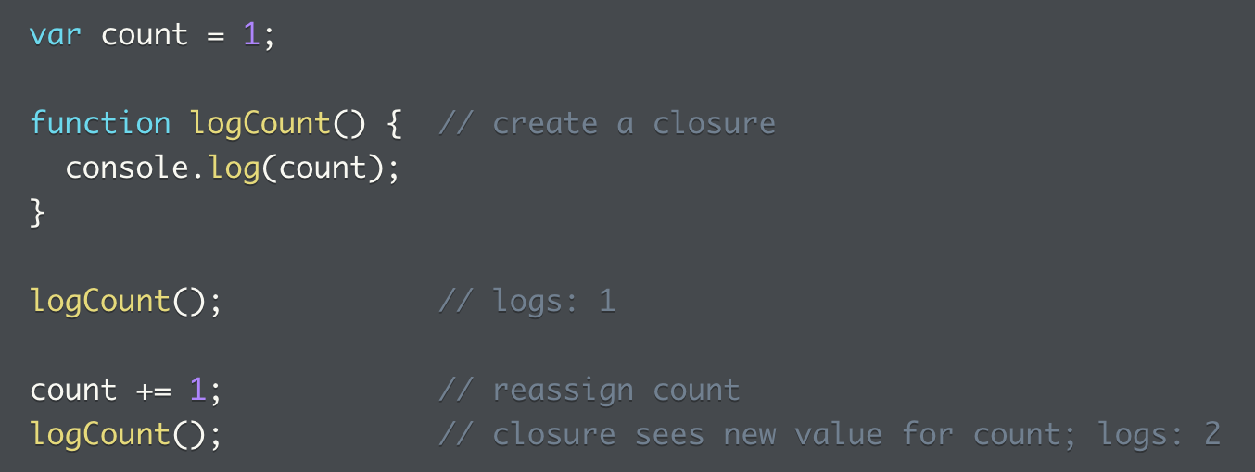
Closures
What are closures?
When a function is defined, it retains access to/closes over the variable scope in effect
This creates a closure
Retains references to everything in scope when closure is created
Retains references for as long as closure exists
Function retains access to references when function is invoked
Referencing the previous example, `greet` can be called anywhere in the program, and it can still access name even if name is out of scope at invocation point
Value of variable can change after creating a closure that includes the variable. The closure will see the new value and the old value is no longer available

Slide 7
Lexical scoping
Lexical scoping is used to resolve variables
The structure of the code is used to determine variable’s scope
Therefore, the source code defines scope
Once a function is written in the code, a scope is created whether it’s executed or not
At any point in a JS program, there’s a hierarchy of scopes from the local scope of code to program’s global scope
When JS searches for a variable, it searches hierarchy from bottom to top, and stops and returns the first variable it finds with a matching name
Variables in a lower scope can shadow/hide a variable of the same name in higher scope
Most mainstream programming languages use lexical scoping (static scoping), some use dynamic scoping

Slide 8
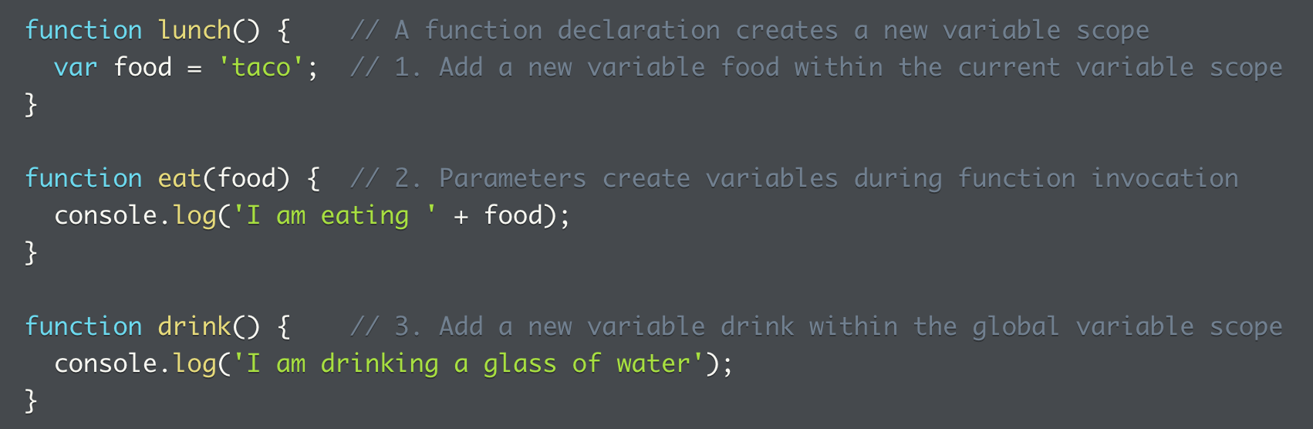
Add variables to current scope
Three ways to create variable in current scope:
1. use `var` keyword
2. use arguments passed to function
3. function declaration itself, creates var with same name as function
Note the food variable from the parameter of the eat function
Given lexical scoping rules, scope is the eat function because of how the source code is written, not because the function gets invoked
At runtime, scope implies food can only be accessed from within body of the eat function

Slide 9
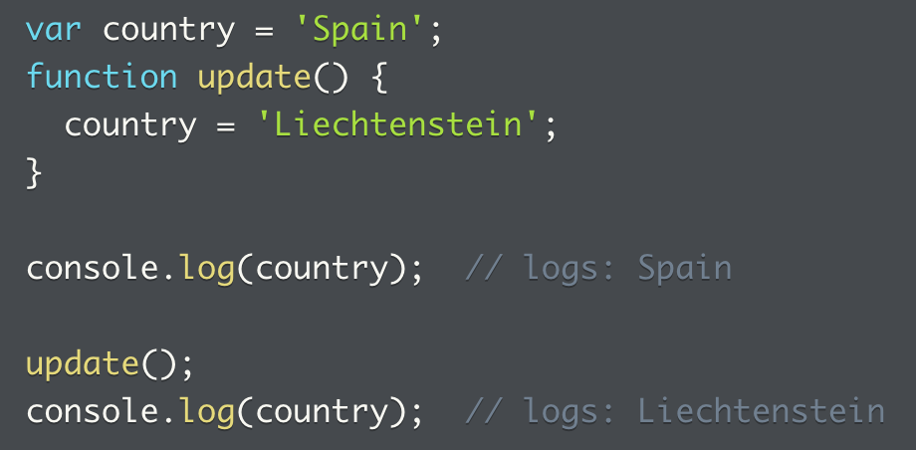
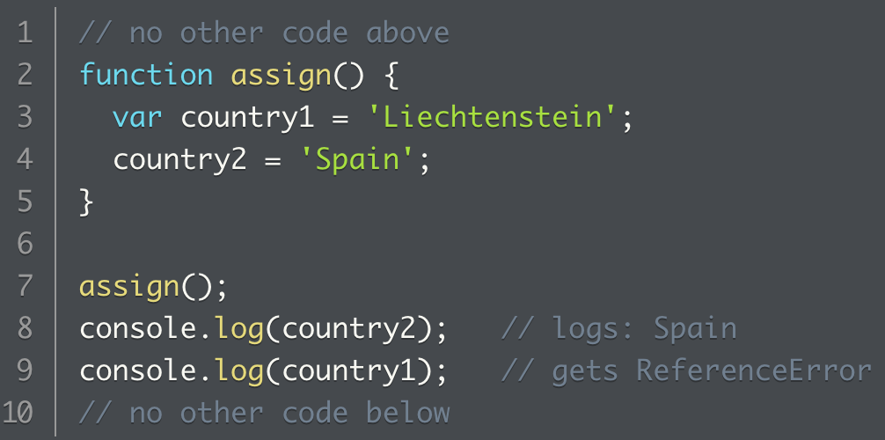
Variable assignment
Var scoping rules apply to both assignment and referencing equally
The below left example code checks first the current code and then each higher scope
If JS can’t find a matching variable, it creates a new global var instead
Below right example, country2 isn’t declared anywhere else in the code, and gets assigned a value inside the function
Since JS can’t find a matching variable, it created a new global variable to make it possible to log on line 8
So country2 is in the global scope because of the way source code is written, not because `assign` function was executed
Country2 isn’t declared anywhere in the code and is assigned a variable inside the function, since there’s no matching variable, a global variable is created

Slide 10
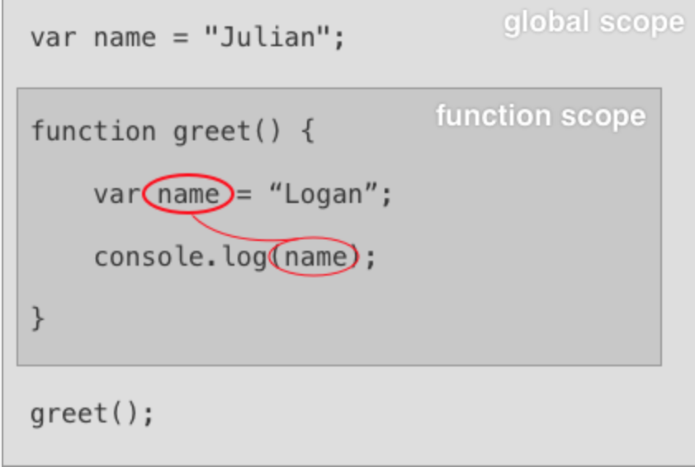
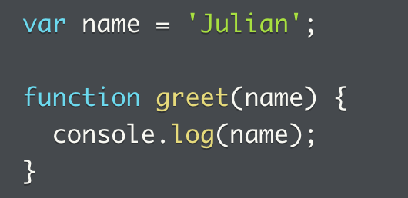
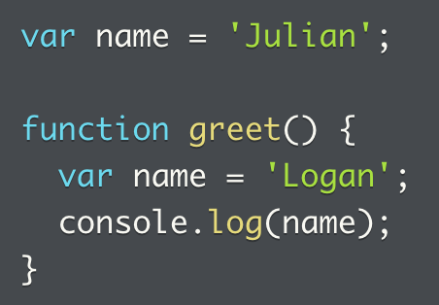
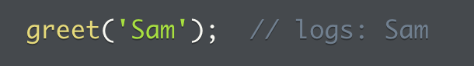

Variable shadowing
Variable declaration from the inner scope can shadow or hide the one from the outer scope
Value of `name` inside `greet` is not dependent on value in outer scope
Instead, `name` receives value passed to `greet` in invocation
A ReferenceError is thrown if it can’t find the variable anywhere in the scope hierarchy
Scoping rules to remember
Every function declaration creates a new variable scope.
Lexical scope uses the structure of the source code to determine the variable's scope. This means that the code doesn't have to be executed for the scope to exist.
All variables in the same or surrounding scopes are available to your code.
Further reading: https://medium.com/launch-school/javascript-weekly-all-about-scope-14f79dabbe16

Slide 11
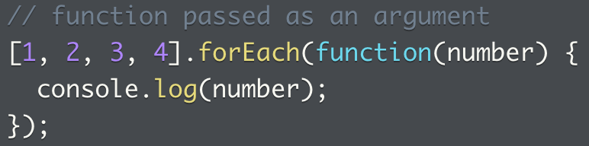
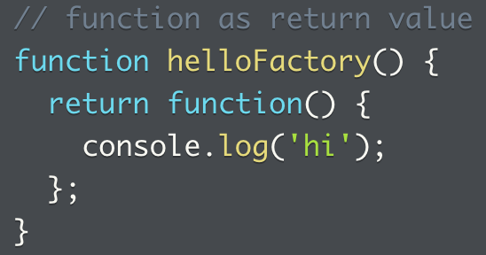
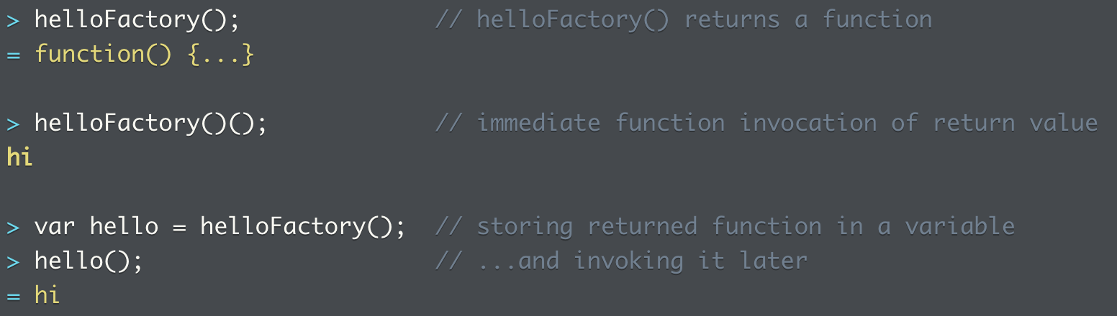
Higher order functions (taking and returning)
Back to this course …
What’s a HOF?
Accept argument when invoked
Return function when invoked
Work with other functions
What’s the mental model here?
Either input or output value is a function
See example of JS built in functions that take function as an argument, or return a function
See three different ways of how functions can return
Returns a function
Immediately invoked function
Stored in a variable, and invoked later

Slide 12
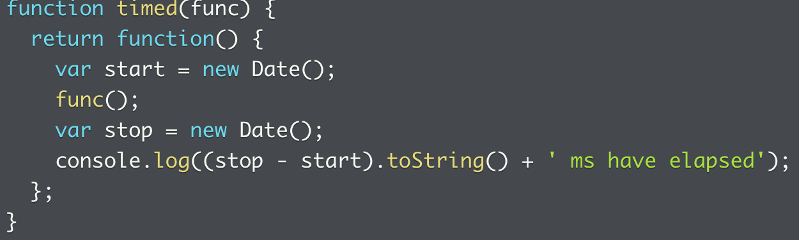
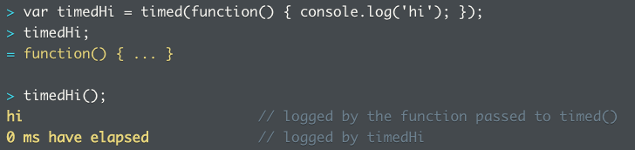
HOF (2)
If can also both TAKE an argument AND RETURN a function
In this case, timed() returns a function that counts the amount of time lapsed
It takes in a function func() that runs in between two Date() objects
The func passed in is specified when the function is invoked

Slide 13
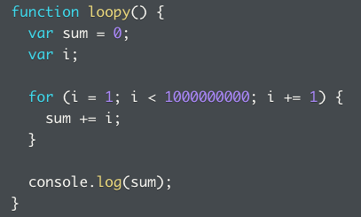
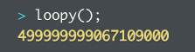
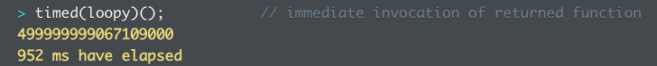
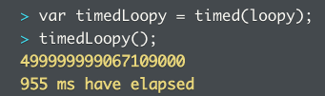
HOF: another example
We can also pass in a more lengthy method to run that takes up more time
A function loopy() is defined and then passed in to the timed() function, and immediately executed
Either via a ()
Or assigned to variable and then executed later
Additional reading: difference between a HOF and first class function: https://stackoverflow.com/questions/10141124/any-difference-between-first-class-function-and-high-order-function

Slide 14
Practice: HOF
1. Characteristics of higher order functions
2. Identify HOF, which one takes in and/or returns a function?
3. Implement a HOF, given an object with a built-in method that calls the to-be-defined function
4. Implement HOF, two examples of how the HOF can be executed. Examples of execution shows different function and operands.
5. Given a HOF is saved in a variable, how to execute it later. This time the input is an array, and it needs to be mutated with the function passed in.

Slide 15
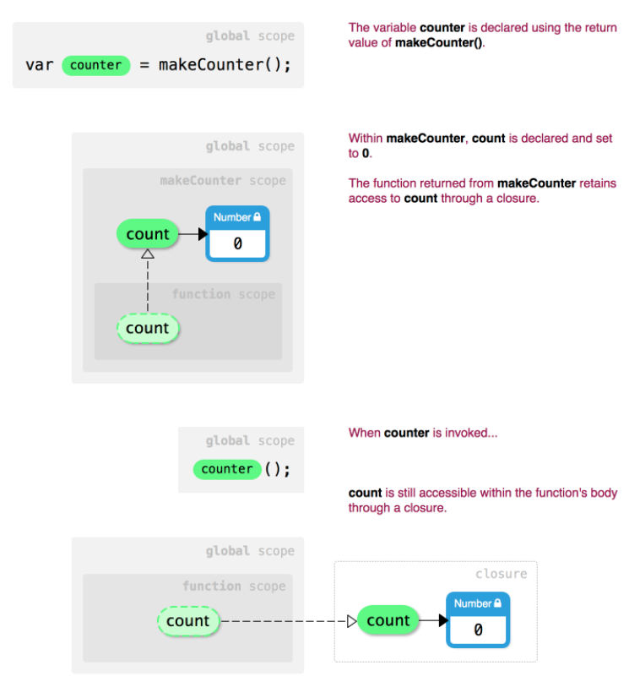
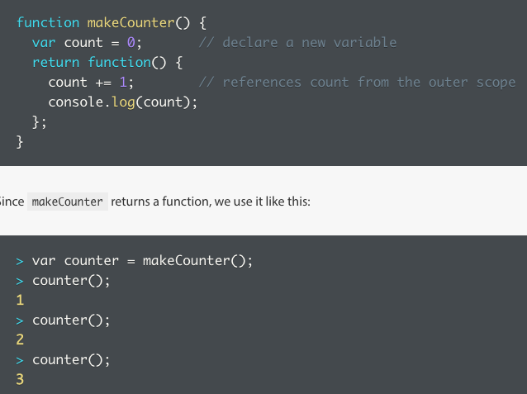
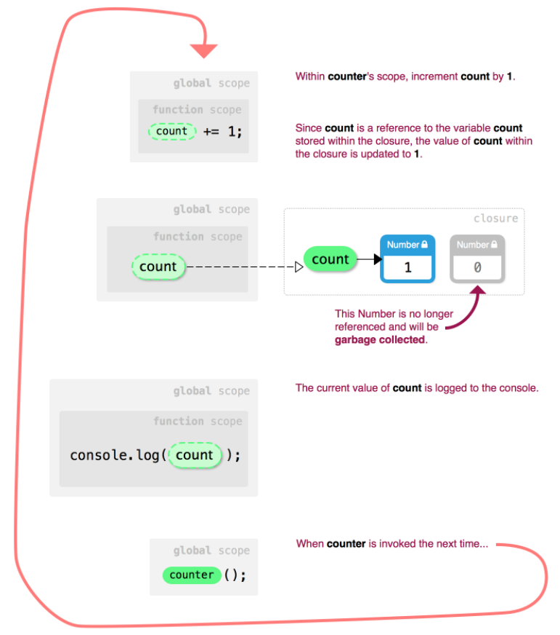
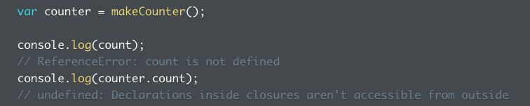
Closures and private data
What are closures?
When functions enclose the context at definition point
Always have access to context regardless of when and where invoked
With the example counter, why does the counter not reset to 0 every time it’s called?
It’s said that counter is stored within the closure, but still, no resetting?
When `makeCounter()` is invoked, it’s the return function that’s called
No, count is reference to variable count stored within closure, value of count within closure updated to 1, the old number is garbage collected
Count is private data
What’s interesting is that if the return value of `makeCounter()` is not saved in the variable `counter`, and we continue to run the function itself, then the counter does not in fact increment
Is it because the `counter` variable saves each iteration of `count`, whereas the function itself does not?
MDN: “A closure is a special kind of object that combines two things: a function, and the environment in which that function was created. The environment consists of any local variables that were in-scope at the time that the closure was created.”

Slide 16
Problems: closures warmup
1. Create makeCounterLogger() that takes number as argument and returns function. When invoked with a second number, count up or down from first number to second number. So the HOF offers one bound, the calling function offers another bound, log the numbers in between.
2. Implement a todo list that does the following:
Add argument to list
Remove argument to list (if already exists)
If no arguments, logs all items
If empty list, log message

Slide 17
Problems: closures
1. Create HOF that logs positive multiple of passed in number up to 100.
2. Write program with add and subtract functions to manipulate running value.
3. Write function that takes two arguments, one a function and the other the argument.
4. The limit of function scope

Slide 18
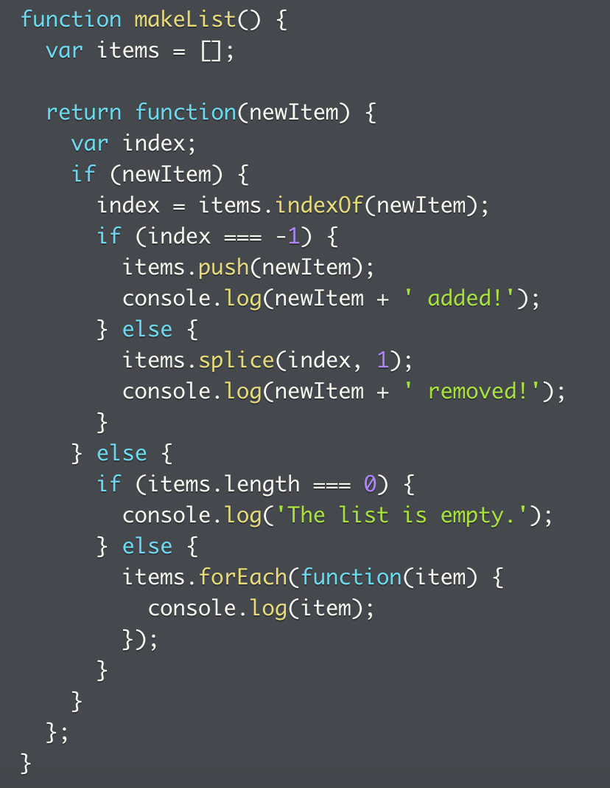
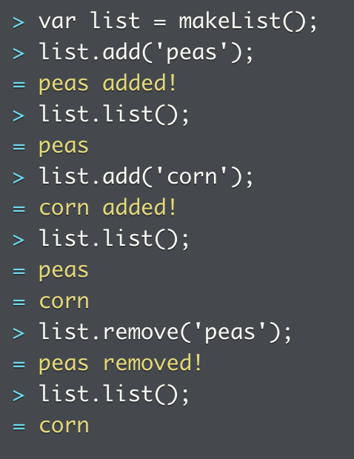
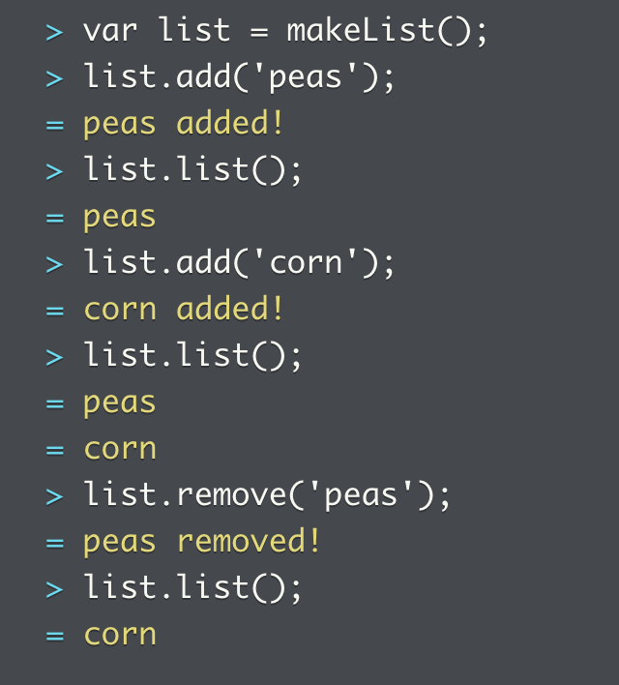
Objects and closures
We try to improve the todo list from earlier by returning an object from the function, instead of the single function
Problems:
Replace makeList() with an object
How to allow access of list.items, but not the object storage (by limiting scope or making methods/variables private)

Slide 19
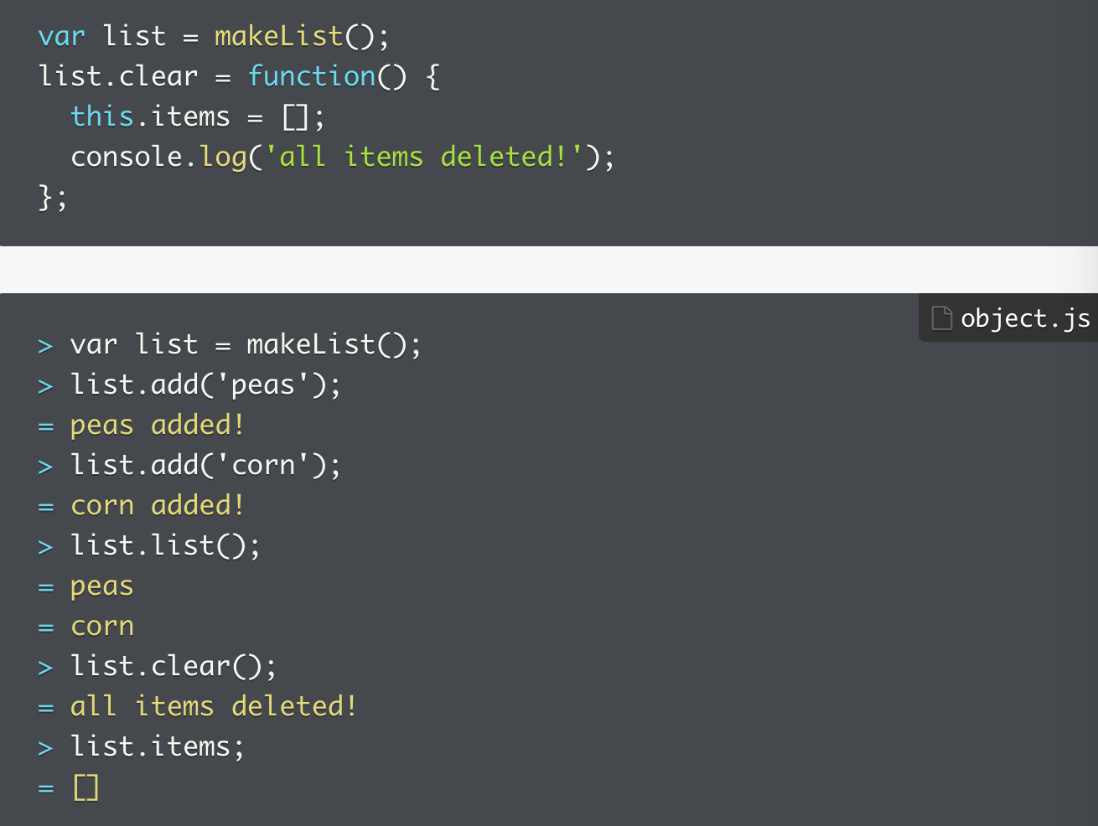
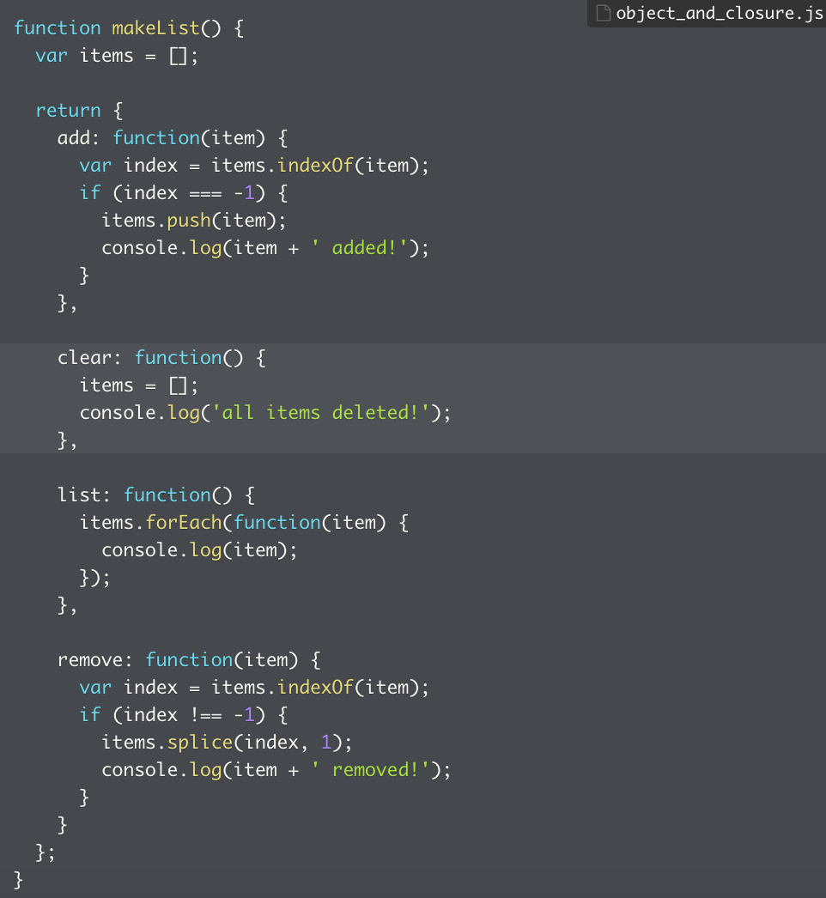
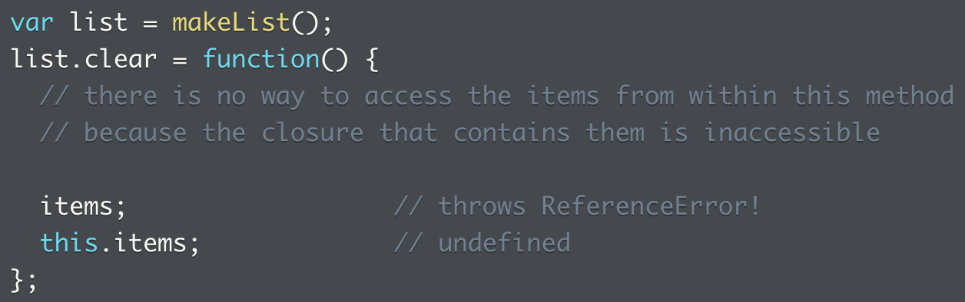
Objects and closures: making data private
Closures can force other devs to use the intended interface
Keeping collection of items private forces access via provided methods
Prevent unintended modification
However, it’s harder to extend the code since adding certain data might be out of scope
The only way to extend the code is to update the original code

Slide 20
Project: objects and closures
1. Build object account, contains balance property
2. Add deposit that takes the value of deposit as argument, add deposit to balance and return.
3. Add withdraw, same as above, limit withdraw to 0.
4. Add transaction that contains array of transactions, each is object with type and amount properties.
5. Account creation code moved to function, new object returned every time.
6. An object manages accounts and that’s the bank. Create bank objects from factory functions.
7. Add openAccount to bank object, so new accounts are created, each starting with account number(start with 101).
8. Add new method that transfers money from one account to another.
9. User can access account balance, number, transactions list by calling methods, but not able to access those properties.
10. User should not access the list of accounts anymore.
Full code here

Slide 21
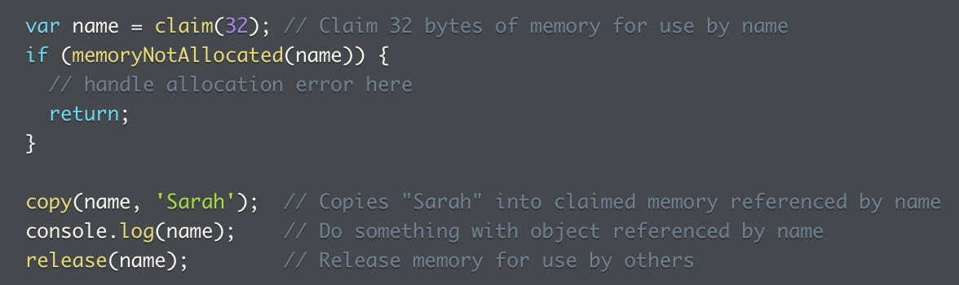
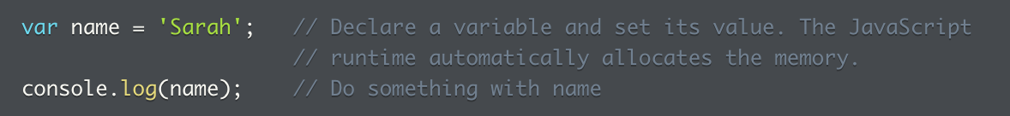
Garbage collection
The act of automatically freeing up memory
What would manual GC collection look like?
Look to the right, imagine if JS doesn’t have automatic GC
First request chunk of memory from system
Release memory back to system when no longer needed
Can’t directly assign values to variables but copy into allocated memory
Verify memory allocation worked?
The process is claim/test/copy/use/release
In JS, can simply declare var and set its value
Runtime handles it
Gets memory from system when new objects and primitive values are created
Released when program has no more references to them
So, when an object or value has no other variables, objects, or closures that maintain a reference to it, the memory is eligible for GC
As long as object/value remains accessible, JS won’t GC

Slide 22
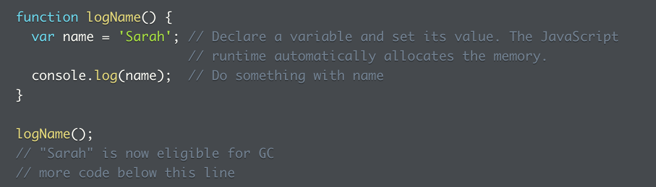
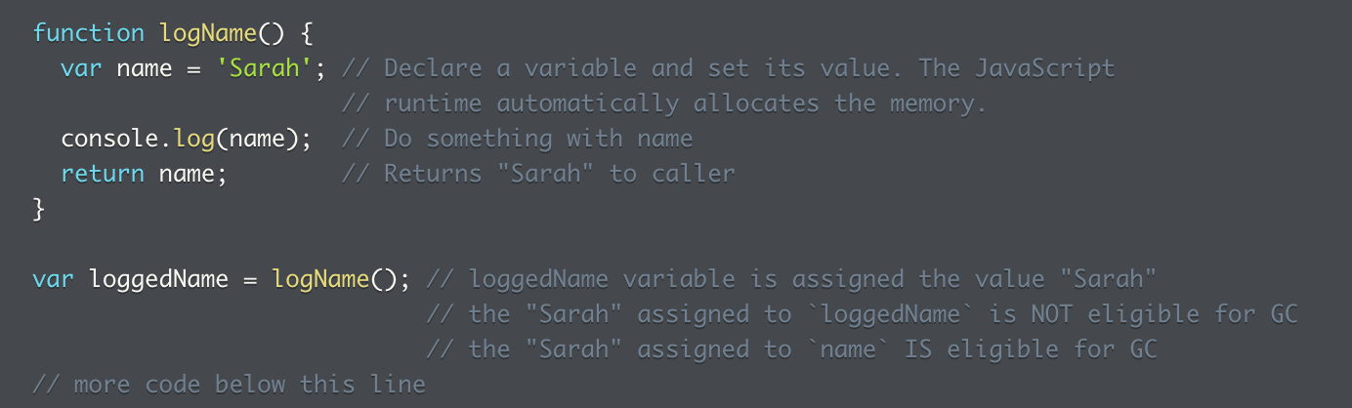
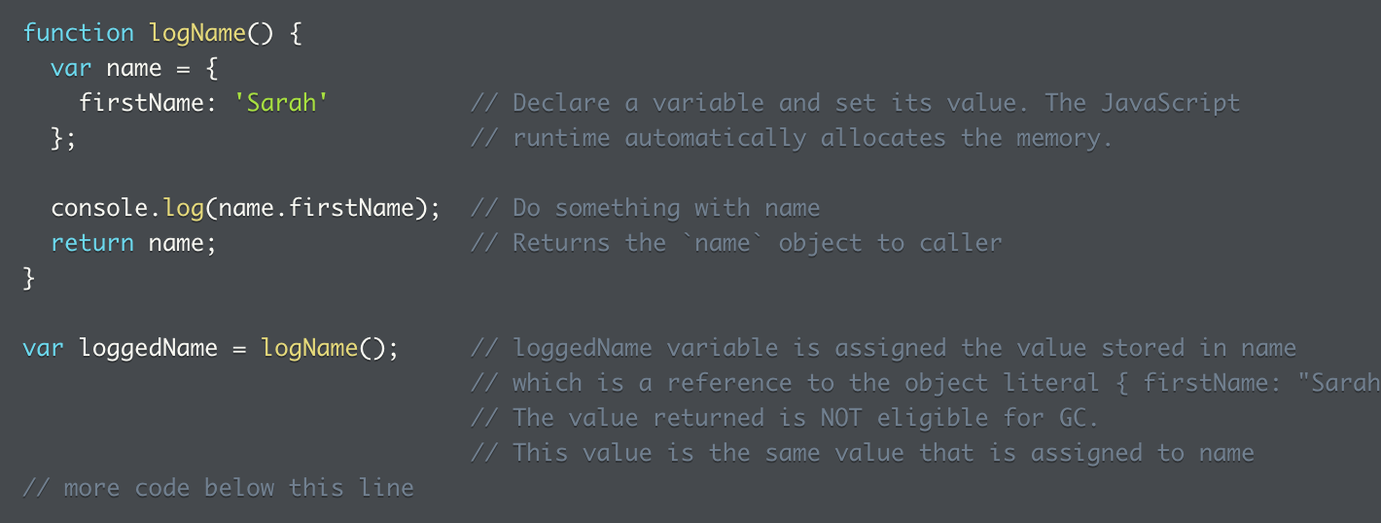
Garbage collection – function example
Moving the last example into a function
When logName returns, Sarah assigned to name becomes eligible for collection
String no longer accessible to code, memory can be released
What if logName returns name, and this is saved?
There are two Sarah values in memory since it’s a primitive value, only one is eligible (remember primitive values get copied and not referenced) for GC
What if logName stores the Sarah value as property of an object?
Then the variable is assigned the value which is a reference to object literal
Value returned not eligible for GC since it’s the same value assigned to name inside the logName()
Note: var is not necessarily eligible for GC when it goes out of scope, not when references to the object or value it referenced may still exist elsewhere
If the var is the sole remaining reference to object or value, then it becomes eligible
Optional reading from MDN on how JS implements GC: https://developer.mozilla.org/en-US/docs/Web/JavaScript/Memory_Management

Slide 23
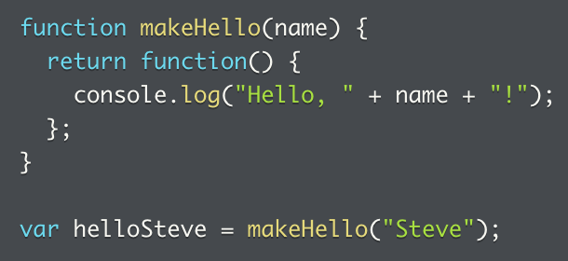
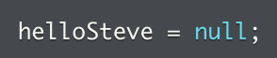
How closures affect garbage collection
Closures stores reference to all variables it can access, each var references an object or primitive value
As long as closures exists, vars remain in existence, objects or values they reference endures
So objects or values referenced by variables the closure keeps can’t be GC’ed
Sidebar, there are cases where a value should be GC’ed but might not be: https://stackoverflow.com/questions/24468713/javascript-closures-concerning-unreferenced-variables
In example, helloSteve references function that closes over name, which now contains Steve string
Closure must keep the name around, references to Steve must also stick around, so this string Steve can’t be GC’ed
When helloSteve is called later, it needs access to name still
Before Steve can be GC’ed, must ensure nothing else in program references Steve, which includes every closure that has access to the Steve string
If that’s necessary, then assign null to the item that references it, this dereferences it -> this way, Steve is dereferenced through the name variable
If nothing else has reference to Steve, then JS can GC it

Slide 24
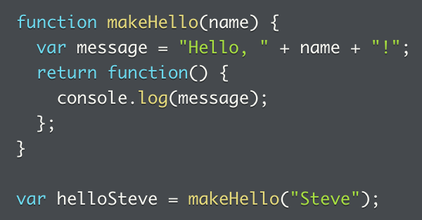
How closures affect garbage collection (2)
What happens when we introduce a variable prior to returning the anonymous function?
Creates message local variable
Anonymous function closes over both name and message variables
This prevents GC on both strings, theoretically
Notice name isn’t referenced within helloSteve function (because name isn’t enclosed in the returned anonymous function), so some browsers might or might not GC collect Steve

Slide 25
Problems: Closures and GC
1. When does GC occur to different variables based on whether they are: global var, part of a function, or part of a function within another function => choices include: after the value is reassigned within a function, after a value is passed in a local function, where it’s copied, so the original copy can be Gc’ed, once a function returns, or once a program terminates
2. When a function execution (with variable) is assigned to a variable, the variable is only available for GC once the programs finishes

Slide 26
Problems: GC
1. What auto GC means
2. What variables are available for GC within a function, when another var is declared in the global scope?
3. When global variables can be GC’ed.
4. When can a function scoped variable be GC’ed, if the variable swas wrapped within a closure.
5. Can a global var ever be GC’ed?

Slide 27
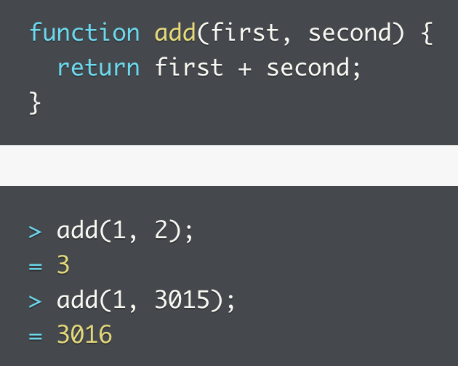
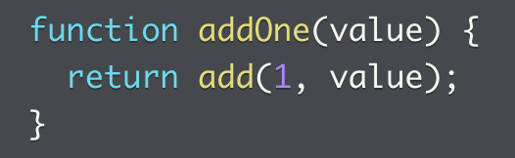
Partial function application
Review that closures allow us to invoke functions with more flexibility
What if we want to call add, but with the first argument set to 1
What if we want even more stability and use different arguments?
Partial function application has the answer

Slide 28
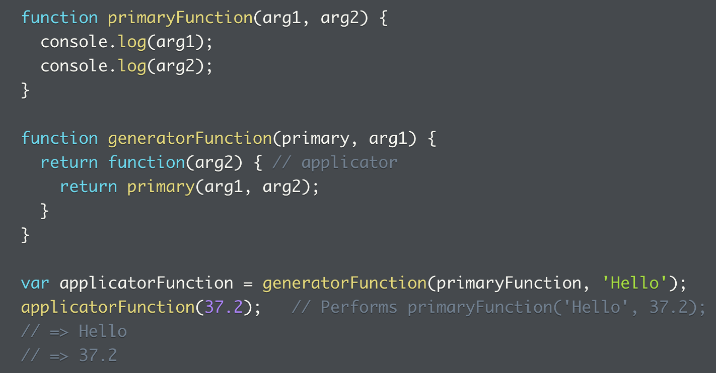
PFA (2)
There are several parts to a PFA
Generator: creates new function
Applicator: function created by the generator
Primary: called by the generator
In the example
The example on the right is not meaningful, but merely to demonstrate the relationship between the primaryFunction, the generatorFunction, and the applicatorFunction created from the generatorFunction
The point of PFA is to time when each argument gets passed in

Slide 29
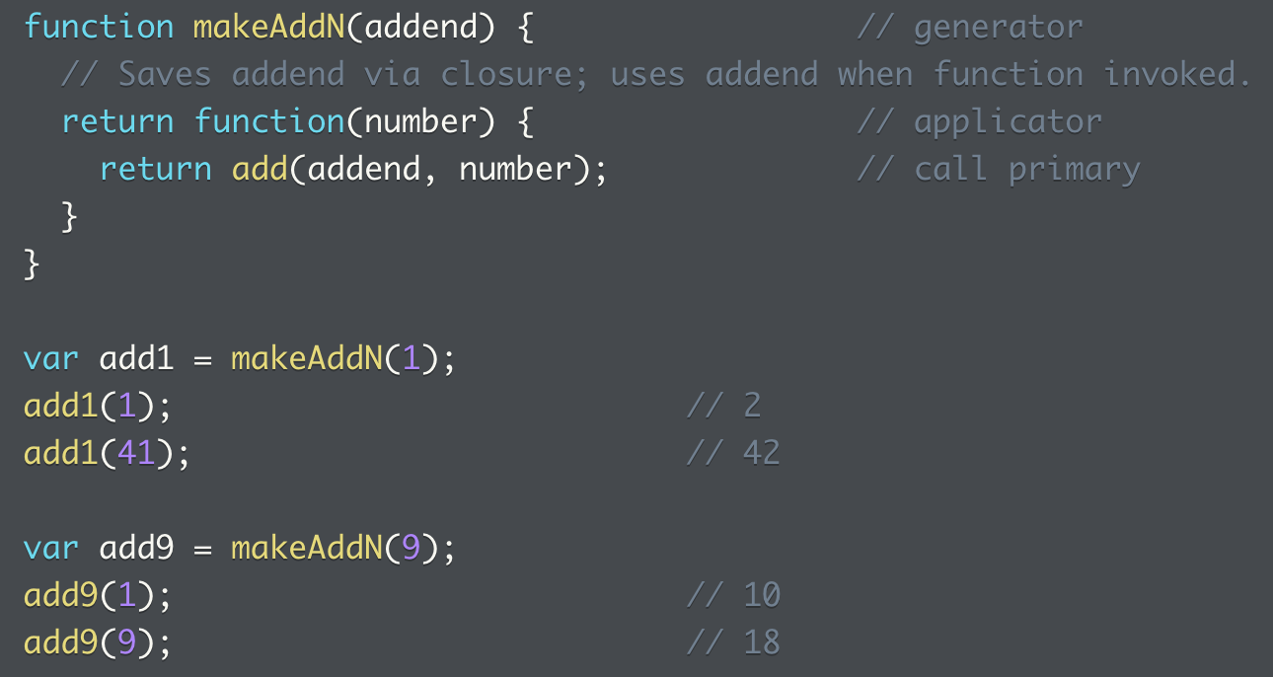
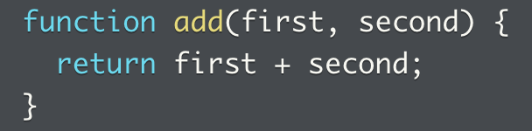
Partial function application: example
Going back 2 slides to the makeAdd example, we can now write a generator function that saves the first number, and returns applicator function called later to add the second number
Primary function: add()
applicator = function(number)
generatorFunction = makeAddN()
Closure let us:
carry around a reference to variable addend, which is a local variable in makeAddN()
Allows applicator to use value of addend later, after makeAddN finishes running
Closure lets us define private data that persists for function’s lifetime
Allows functionality and data to be packaged together
Functions can be passed around without losing private data

Slide 30
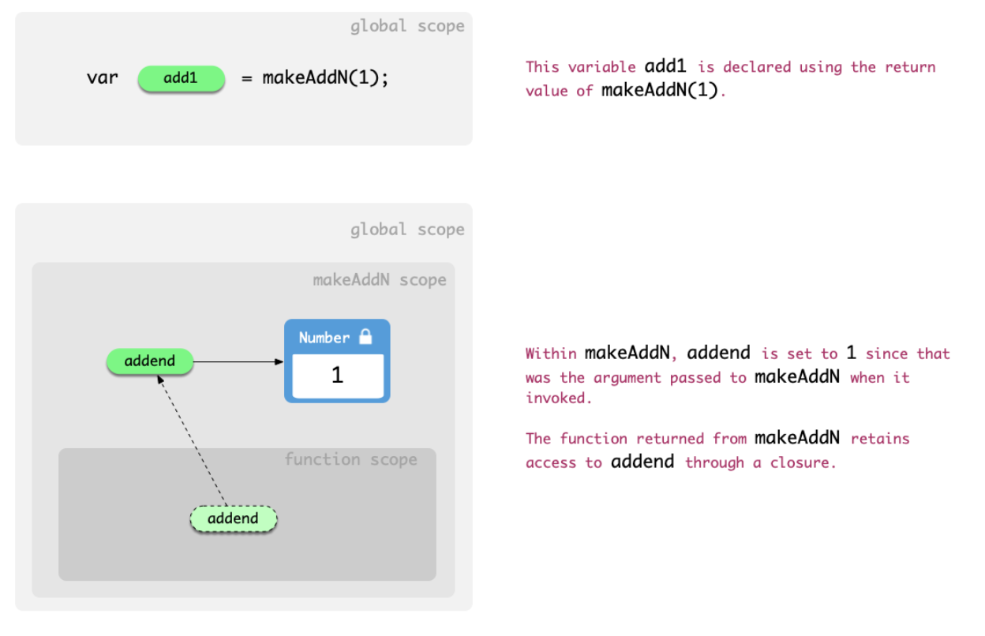
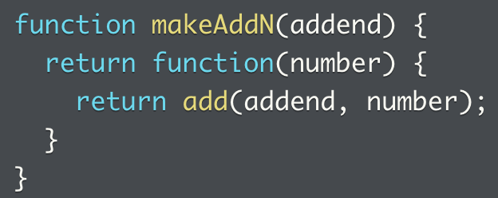



How partial function application works: closure and limitation
How closure works with the makeAddN() function
Problem: not reusable, what if we want to have a multiply primary?

Slide 31


Partial function application: a more flexible approach
Create general purpose generator function, applies single argument to any two-argument primary
Primary function: add()
Generator function: partial()
Creator function: add1()
Partial function: repeat()
In the example on the right, the creator function is assigned the execution of the generator function, which takes a partial function in as an argument; the creator function then passes in a second parameter that works together with the primary function

Slide 32


PFA: using bind()
While bind() can be used to set an explicit execution context, it can also be used to make a function with pre-specified initial arguments
Instead of assigning threeTimes() with partial, this can also be done with bind()
Closures have lots of similarities to objects, both allow code to be organized into data, and behavior that relies on that data

Slide 33
PFA: follow-up problems
1. Function that returns greetings.
2. Create a partial function that returns the right greeting when passed a name in the creator function.

Slide 34
Practice problems: PFA
1. Use PFA to implement the generator function.
2. Implement the generator function.
3. Implement a more generic generator function.
4. How does closure work with a PFA?
When a new function is created, it retains access to all of the references visible to it in the lexical location of its creation
5. Implement the generator function.

Slide 35




Immediately invoked function expressions
What is an IIFE?
Anonymous function defined and invoked simultaneously,
Looks like: pair of () around the function expression, () at end invokes function
Without the () around the function expression, the function can’t be invoked
() around a value doesn’t change the value, it’s a grouping operator that controls evaluation in expressions
So () results in the evaluation of what’s inside the expression, () means we want to parse the function definition as an expression, () means we can immediately invoke

Slide 36



IIFE (2): takes arguments and return values
IIFE can take arguments and return values
Or in a different style, where argument list is inside outer set of parentheses
() can be omitted when function definition is an expression and doesn’t occur at beginning of line

Slide 37



IIFE: why is it useful? Private scope
First, look at some potential problems: here’s a program that requires some addition
Log some values, but there’s a problem: if `i` already exists in the global scope, then this might alter the existing value
In that case, functions create their own scopes, so variable can be hidden from rest of the program
But another problem, does the program already contain a loopAndLog() function in the global scope? Otherwise one will overwrite another

Slide 38


IIFE: solution to not override other variables in the global scope
Turn function declaration and invocation into IIFE
Has private scope for `i`, no clashing
Can also be passed into IIFE during invocation

Slide 39


IIFE: return FUNCTION with access to private data
E.g. a function that generates unique numbers
What if the `studentId` is reassigned unintentionally?
Then the function will not return unique IDs
Alternative? Function takes argument the user of function has control
Challenge: uniqueness of ID dependent on how well user can keep track of previously generated
IIFE: function is responsible by itself for tracking ID, without exposing IDs to being unintentionally reassigned
A creator function is assigned to an anonymous function, which returns another anonymous function
This function is immediately returned

Slide 40



IIFE: return OBJECT with access to private data
Implement an object that maintains properties of items, one logs count of each item
Problem:
How to validate items (for duplicates) when pushed in? Add validation

Slide 41



IIFE: return OBJECT with access to private data (2)
Can no longer add items that exist already
But users can still push items directly into the stocks list
IIFE can be used to make the list private, so new stocks can only be added using the designed method
An object would not be able to shield part of its content off
Only through turning it into a function expression, can we return some properties but make the data private
Not entirely clear why this won’t work if the function is not wrapped up as a function expression and immediately executed: error => inventory.addStock is not a function
Can actually use function inventory() as an object factory and the object made from this function will also have the same scope (private data plus access to proper functions)

Slide 42

IIFE: return OBJECT with access to private data (3)
Can also refactor the validating function to a private function
Note if the anonymous function isn’t wrapped up as a function expression and immediately executed, this won’t work

Slide 43
Practice: IIFE
1. Can function expressions execute without () around it?
3. How to fix it when there’s a naming conflict between a function and other variables used earlier, how to fix it with IIFE while passing in the correct arguments.
4. Use an IIFE to generate a countdown function, where the inner function returns the IIFE
5. Scope of IIFE outside the function scope
6. Recursive solution for question 4 -> need to add another variable, unlike the last solution, the structure is completely different

Slide 44
Summary
Closures let a function access any variable that was in scope when the function was defined.
Values that are no longer accessible from anywhere in the code are eligible for garbage collection, which frees up the memory that they used for reuse by other parts of the program.
You can use closures to make variables "private" to a function, or set of functions, and inaccessible elsewhere.
Closures allow functions to "carry around" values for later use.
Higher-order functions are functions that take a function as an argument, return a function, or both.

Slide 45
Practice: Function Context, Scope, and Closure exercises set
1. What `this` is in the global context, and two ways to fix it
2. How to preserve the scope of `this` in a function
3. Solving for the same issue with a hard bind
4. Create your own bind()
5. A more complex myBind(), this is still puzzling, see the question from Casey
6. Editing the filter() method to give it scope, this is the time to understand how `call()` works
7. Garbage collection
8. Building a stack
9. Shifting object scope from global to local using IIFE
10. Refactor the school object (need to redo the original for this to make sense)

Slide 46


4-5 - Practice: the implementation of bind()
A simple implementation
The function takes in two arguments and returns a function
What is returned? Using one of the passed in argument as a function, and `apply()` two arguments to the passed in in function, taking in context, and arguments
This requires an understanding of apply, see next slide
An implementation that supports partial function
More on this next slide

Slide 47



5- How the improved bind() works
First we see it in action, passing in the `addNumbers()` function
`console.log(arguments)` on line three => [Arguments] { '0': [Function: addNumbers], '1': null, '2': 5 }
So `arguments` represents everything passed in when `myBind()` is called
`console.log(partialArgs)` => [5]
This is basically processed as `arguments[2]`
`console.log(remainingArgs)` => [10]
This is passed in when `addFive(10` is invoked;
[].slice => returns a new array that’s duplicated, since [].call doesn’t work; this is the same as new Array().slice
In the cases of partialArgs and remainingArgs, `apply` does something totally different
[].slice.apply(arguments, [2]), is the same as => [arguments[2]]
It’s interesting because function invocation and function execution parameters do not match
That’s because func = addNumbers, ctx = null, and 5 isn’t specified as arguments, but if we pass it in, we can use it immediately, see my solution 2 on the right
When defined, it takes in two arguments `func` and `ctx`, when executed, three arguments are passed in (function, null, and 5)
Is there really a need for the calling function to be defined with a null as parameter?
My alternative codes on the right

Slide 48


5 -Another implementation of the bind()
What it does is concatenating the two sets of arguments together, which are passed in from the myBind() invocation and the function expression invocation
Then use `apply()` to execute them
Note obj = null, f = function add5(), and args represents the third element

Slide 49


5 - How `Function.prorotype.apply()` works
func.apply(thisArg,[ argsArray])
thisArg is the value of this provided for the call to func
Return value: result of calling the function with the specified this value and arguments
On a side note, apply also has this ability

Slide 50

5 - Another slide on apply()
With large value arrays, can use the hybrid strategy of applying function to chunks of array at a time

Slide 51

6. How `call()` works
func.call([thisArg[, arg1, arg2, ...argN]])
Although `thisArg` is optional, if context gets screwy, then need to use call (or apply) to specify the context
This example uses the 3rd option listed below, where it uses `call()` to invoke function and specify the context for `this`
Documentation gives good examples of how `call()` can be applied:
1. Use `call` to chain constructors for an object
Constructor for Product object is defined with parameters: name, price
Food and Toy invoke Product, passing this, name, and price
Product initializes properties name, price, both functions define category

Slide 52



6. How `call()` works continued
2. Use `call()` to invoke an anonymous function
Create anon function, use call to invoke it on every object in an array
Passing the object as `this` is not strictly necessary but to illustrate a point
The purpose of the anon function is to add `print` to every object, which prints the correct index of object in array
3. Using `call()` to invoke function and specify context for `this`
When `greet` is called, value of this is bound to object `obj`
4. Use `call()` to invoke function without specifying first argument
Invoke function without passing first argument, it no first argument, then `this` is bound to global object
Returns “sData value is Wisen”

Slide 53
Quiz

